Slide 1
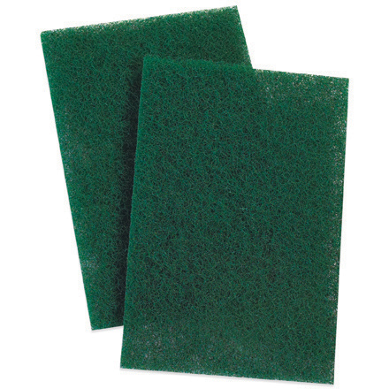
Non-woven Abrasive Pads
A plastic abrasive pad. Non-rusting and washable. Commonly called Scotch-Brite pads (3M brand name).
Notes:
Painting-Painting And Glazing Equipment Image: Sctoch Brite.jpg Height: 440 Width: 440

Slide 2
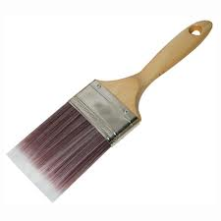
Paint Brush
Natural bristle brushes are used for oil based paints. Polyester and nylon brushes are used with water based paints. Sizes are commonly found from 1” to 6” widths. Clean immediately after using with solvent appropriate for the type of paint used.
Notes:
Painting-Painting And Glazing Equipment Image: PaintBrush.jpg Height: 135 Width: 135

Slide 3
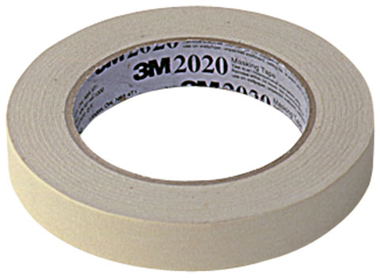
Masking Tape
It will adhere to paper, glass, walls and metal and is easily removed.
Notes:
Painting-Painting And Glazing Equipment Image: MaskingTape.jpg Height: 352 Width: 480

Slide 4
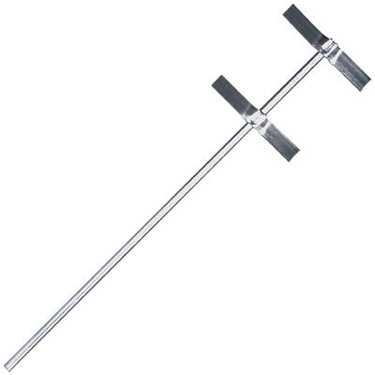
Mixing Paddle
Used in an electric drill to stir paint and other liquids.
Notes:
Painting-Painting And Glazing Equipment Image: PaintBlender.jpg Height: 240 Width: 240

Slide 5
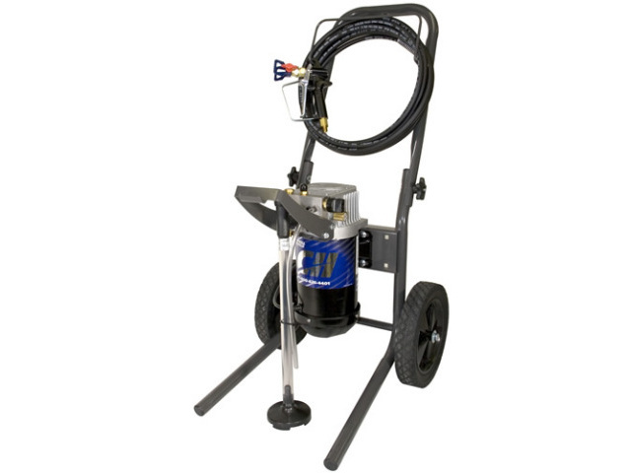
Airless Paint Sprayer
No thinning is required and very little over-spray is developed. Uses a positive displacement pump to pump the paint at high pressure.
Notes:
Painting-Painting And Glazing Equipment Image: AirlessSprayer.jpg Height: 231.9463 Width: 309.2617

Slide 6
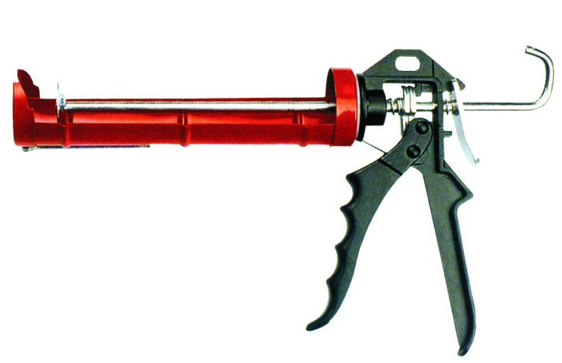
Caulking Gun
One to two pound cartridge refills are available in various colors.
Notes:
Painting-Painting And Glazing Equipment Image: CalkingGun.jpg Height: 460 Width: 711

Slide 7
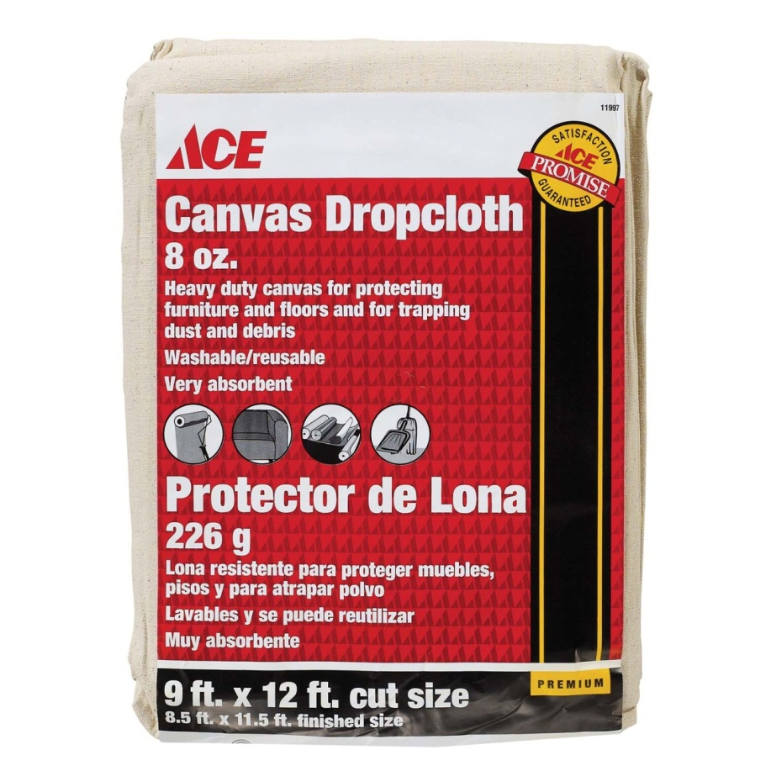
Drop Cloth
Disposable cloths are made of paper or plastic and permanent cloths are made of canvas or soft cotton cloth.
Notes:
Painting-Painting And Glazing Equipment Image: DropCloth.jpg Height: 1305 Width: 1305

Slide 8
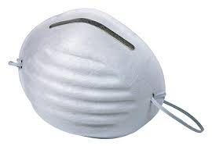
Dust Mask
This mask is disposable and should not be reused.
Notes:
Painting-Painting And Glazing Equipment Image: DustMask.jpg Height: 112.2 Width: 162

Slide 9
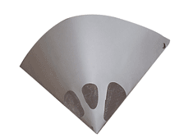
Filter
Used to filter foreign material from paints, particularly those used in paint guns.
Notes:
Painting-Painting And Glazing Equipment Image: PaintFilter.gif Height: 100.8 Width: 134.4

Slide 10
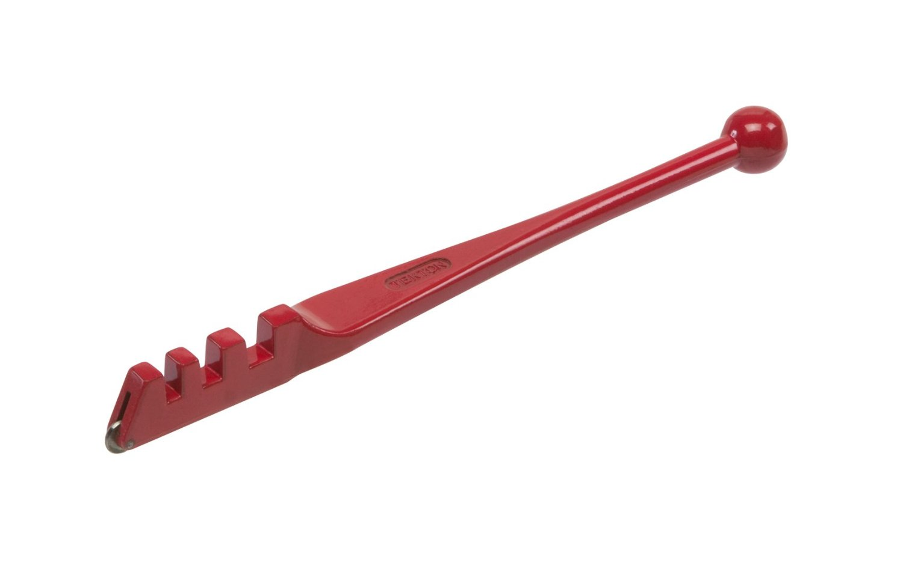
Glass Cutter
Pressure applied on the glass from beneath the scratch or tapping gently will cause it to break cleanly along the cutter line.
Notes:
Painting-Painting And Glazing Equipment Image: GlassCutter.jpg Height: 571.2 Width: 900

Slide 11
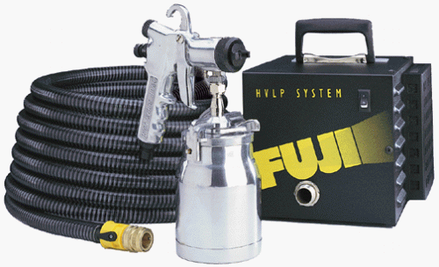
High Volume Low Pressure Sprayer
Similar in design to an compressed air sprayer, but low pressure produces less fine spray, causes less drift, and air pollution.
Notes:
Painting-Painting And Glazing Equipment Image: HVLP_Sprayer.gif Height: 182.4 Width: 300

Slide 12
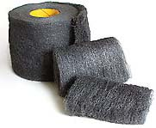
Steel Wool
Comes is pads or rolls and size is designated by 4/0, 3/0, 2/0, 1/0, 0, 1, 2, 3, 4, with 4/0 being the finest and 4 being very coarse.
Notes:
Painting-Painting And Glazing Equipment Image: Steell Wool .jpg Height: 35.76 Width: 43.44

Slide 13
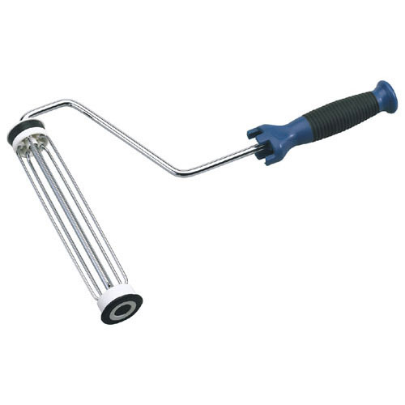
Paint Roller And Pan
Special rollers are available for painting corners and trim.
Notes:
Painting-Painting And Glazing Equipment Image: Paint Roller.jpg Height: 300 Width: 300

Slide 14
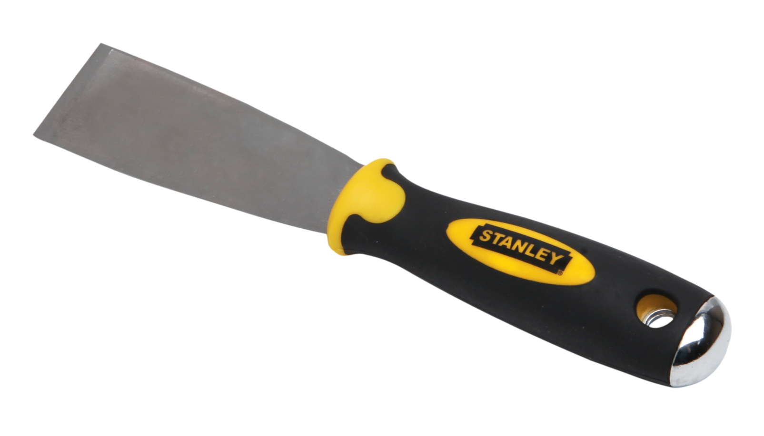
Putty Knife
Sizes range from 1 inch to 12 inches. Used to apply putty to the window sash to seal the glass. A flexible bladed knife for applying putty and spackle. Stiffer knives can be used for scraping
Notes:
Painting-Painting And Glazing Equipment Image: PuttyKnife.jpg Height: 399.9272 Width: 701.3455

Slide 15
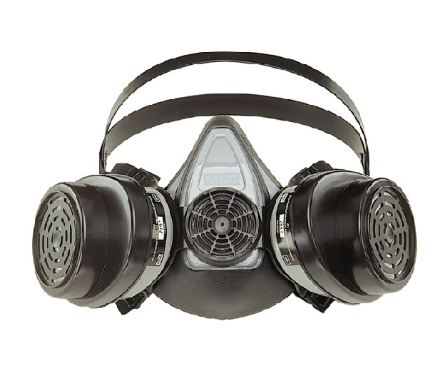
Respirator
This filter system is far superior to the dust mask.
Notes:
Painting-Painting And Glazing Equipment Image: Respirator.jpg Height: 117 Width: 135.675

Slide 16
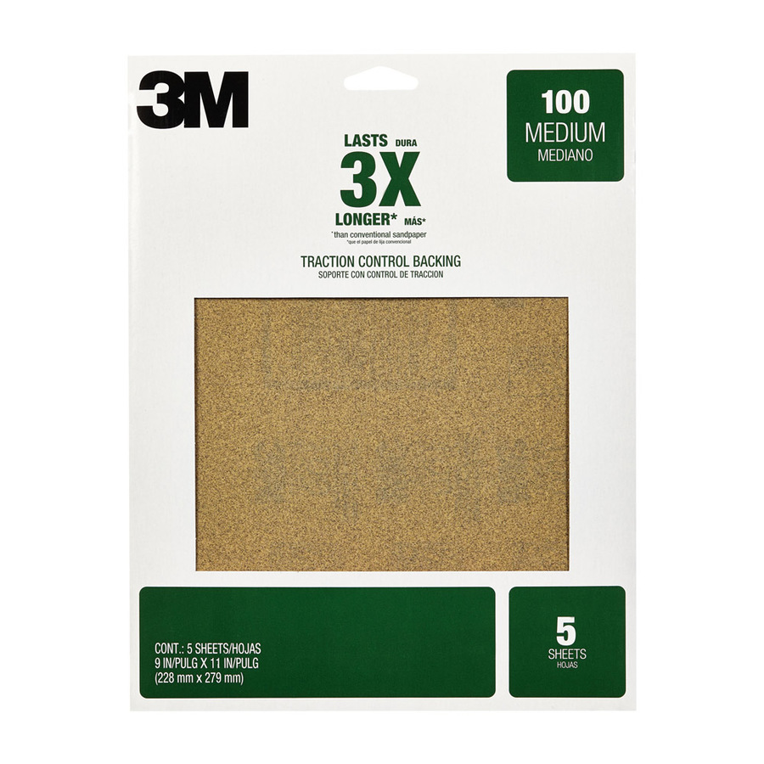
Sandpaper
Comes in various grits from very fine to very coarse.
Notes:
Painting-Painting And Glazing Equipment Image: Sandpaper.jpg Height: 900 Width: 900

Slide 17
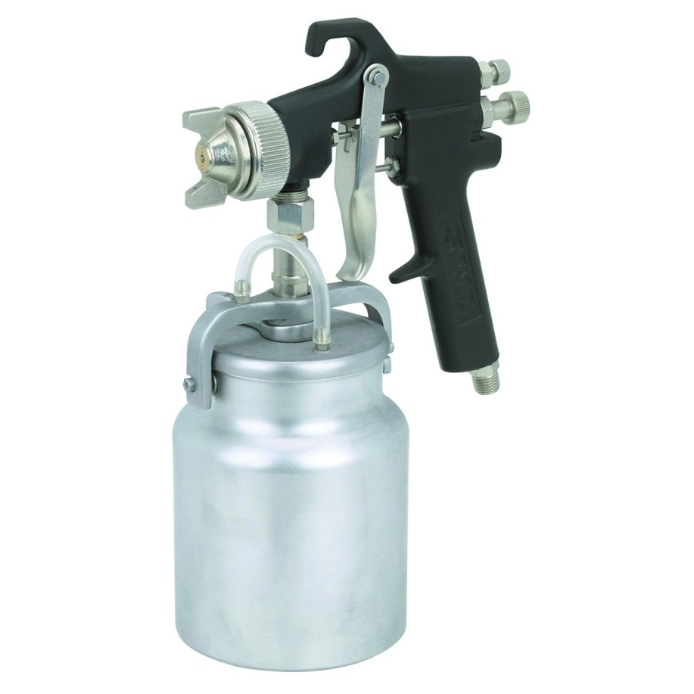
Spray Gun
Should be used in a closed area with proper ventilation and good air filtration. Uses compressed air to spray the paint.
Notes:
Painting-Painting And Glazing Equipment Image: Spraygun.jpg Height: 720 Width: 720

Slide 18
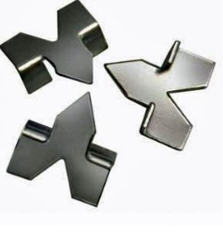
Glazier Points
The glazier points, triangular pieces of zinc coated metal, are driven into the sash about 6 inches apart to hold the glass in place.
Notes:
Painting-Painting And Glazing Equipment Image: GlazingPoint.jpg Height: 187.5 Width: 180.75

