Slide 1
OATA Electrical Workshop
June 2023

Slide 2
Welcome & Introductions
Mike & Lynn
Introduce yourself. Name, School, Ag Mech Teaching experience (classes and years)

Slide 3
Agenda
Introductions and Introduction, Safe Practices
Tool & Materials ID
Basic Circuits
Board Building
Troubleshooting
Wiring Rules NM vs. Conduit
Wiring Problems with 3 box Board (Conduit)
Panel Wiring, Wire sizing, Circuit Protection
Wiring CDE Boards (NM)
Planning, Testing Projects, Rubrics, & Grading
Wrap Up

Slide 4
Workshop Goals
Hands on – practice skills
Teaching ideas (methods)
Provide resources

Slide 5
Electrical Skills
Used in residential and commercial wiring (AC)
Homes
Irrigation
Used in mobile equipment (DC)
Many agricultural jobs require some electrical knowledge
Can be taught without a shop!
Require high level thinking
Addressed in many AFNRS standards
Part of the Oregon and National Ag Mechanics CDE

Slide 6
Class Materials
Handouts (binder)
Agenda
Oregon FFA Electricity Unit
Tool and Materials ID Answer Sheet
Common Electrical Circuits Worksheet
Electrical Board with Conduit and Projects
OATA Electrical Troubleshooting Activities
Electrical Board with Conduit and Projects
Oregon Ag Mechanics CDE Project Panel
Additional resources including all PPT
http://agedweb.org/oragmechanics/workshop2023.htm

Slide 7
FFA Curriculum
Developed by 4 shop teachers
FFA Electricity Curriculum
PPT, Worksheets, assessments, videos

Slide 8
Electrical Skills
Electricity is a bit different that other skill areas like woodworking and welding
Wiring is rules based
Measuring is minimal
Requires more higher-level thinking
Troubleshooting requires knowledge and problem-solving skills

Slide 9
Terms
Current – electricity flowing through a wire (Amps)
Ground wire that is literally connected to the earth. This is a safety path and carries no current
Hot wire is connected to the power source
Neutral wire is connected to ground and carries current
Conductor – wire
Device – generic term for things connected to power such as outlets, lamps, switches

Slide 10
Safety
Electricity can kill! 75mA through the body can stop the heart
The higher the voltage the greater the danger
Arcing can burn
Always shut off power before working on a circuit. Test it!
Wire to Code to insure safe wiring

Slide 11
What’s wrong with this picture?

Slide 12
Tool and Material ID
Like any area electrical wiring has its own specialized tools and materials.
Part of instruction should be identification using accepted industry names
Incorporate ID into lessons and demonstrations
Activity
Electrical 02-ID Complete Review.pptx

Slide 13
Troubleshooting
Basic multi-meter functions
Resistance/Continuity
AC Voltage
DC Voltage
On-line multi-meter reference
On-line key to stations
Work in pairs taking turns with the tools.

Slide 14
Wiring Boards
Simple NM with nail on boxes
Simple Conduit Boards
Complex boards with panels

Slide 15
Simple Boards

Slide 16
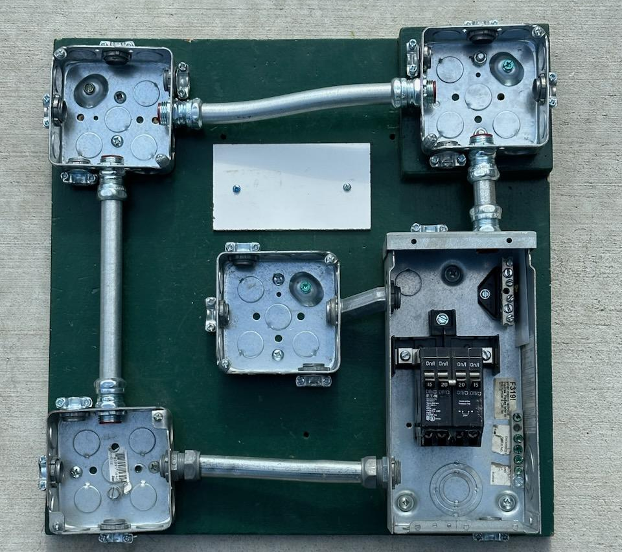
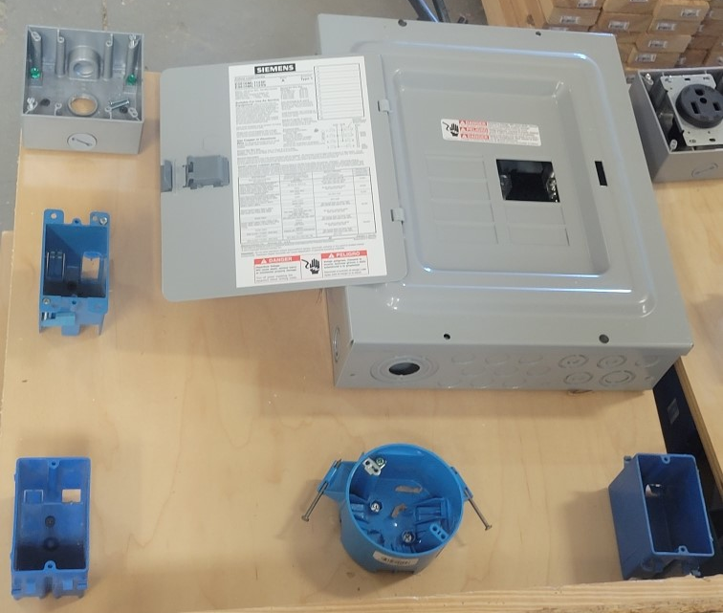
Complex Boards

