Slide 1
Planning, Testing Projects, Tools, Rubrics, and Grading
June 2023

Slide 2
Planning
Building boards – one time expense
Range from simple plastic box for NM cable < $5
Metal boxes and conduit
Combination boards
Boards with panels > $40
Ideally need enough boards so they can be graded later. Depends on class size and rotation strategy.
Devices
Switches (toggle and 3 way)
DR
Lamps
Breakers for panels
Devices will break so plan for some replacement
Consumables
Wire is main expense
Wire can be reused to some extent. Used wire makes good “pig tails”

Slide 3
Materials Spreadsheet
Build one for your project(s)
Use for budgeting, inventory and ordering
Key points:
Use common quantities (ex. 500’ THHN wire or 250’ 14/2 NM cable)
Determine a per student amount (allow for waste)
Calculate the quantity needed then round up to whole units for ordering
Spreadsheet

Slide 4
Tools
Tools are modest
Screwdrivers
Wire strippers
Utility knives or cable rippers for NM

Slide 5
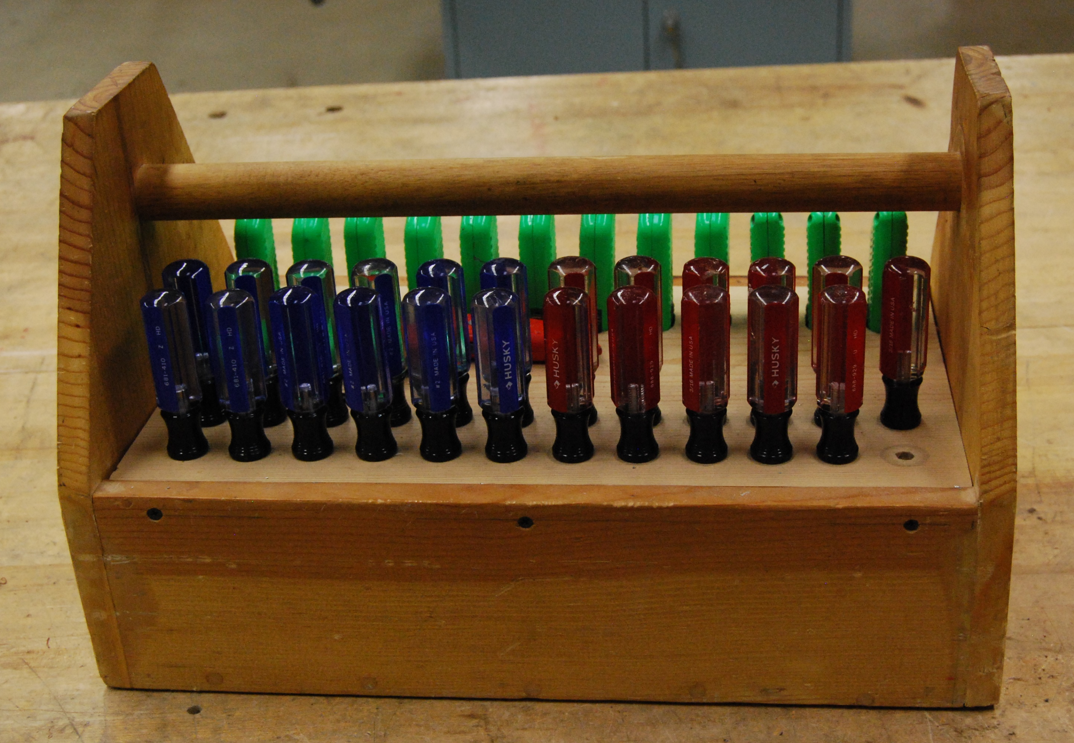
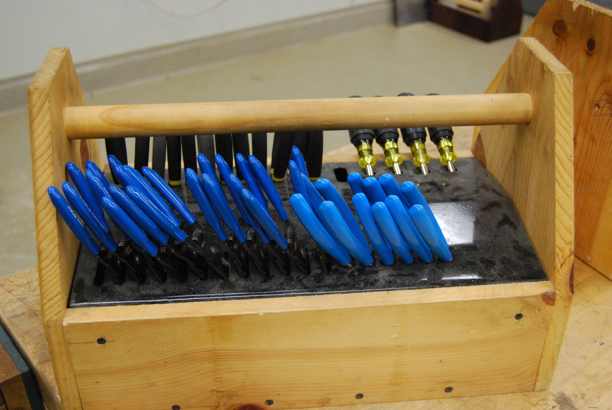
Tool Storage
Consider a caddy for tools or a separate cabinet
Should be easy to inventory. Put tape over missing slots
Do not use for other skills!

Slide 6
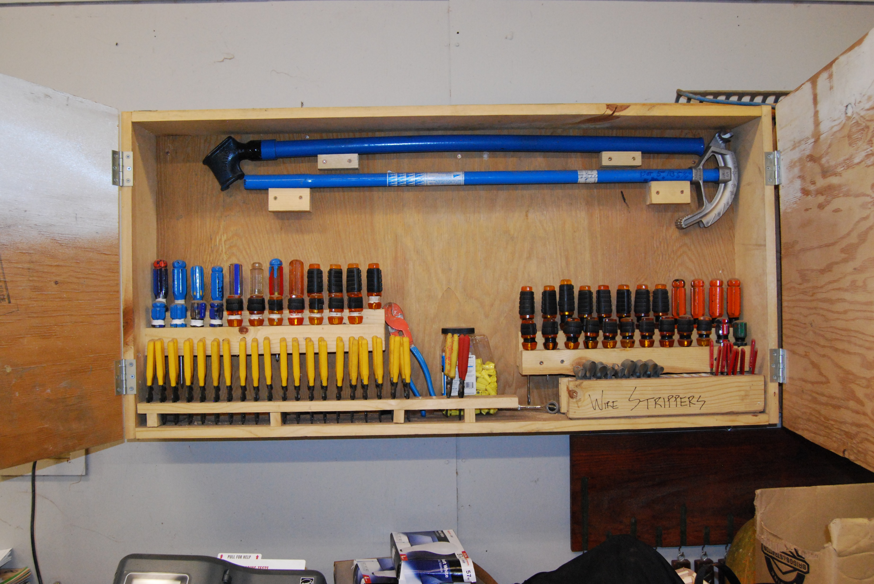
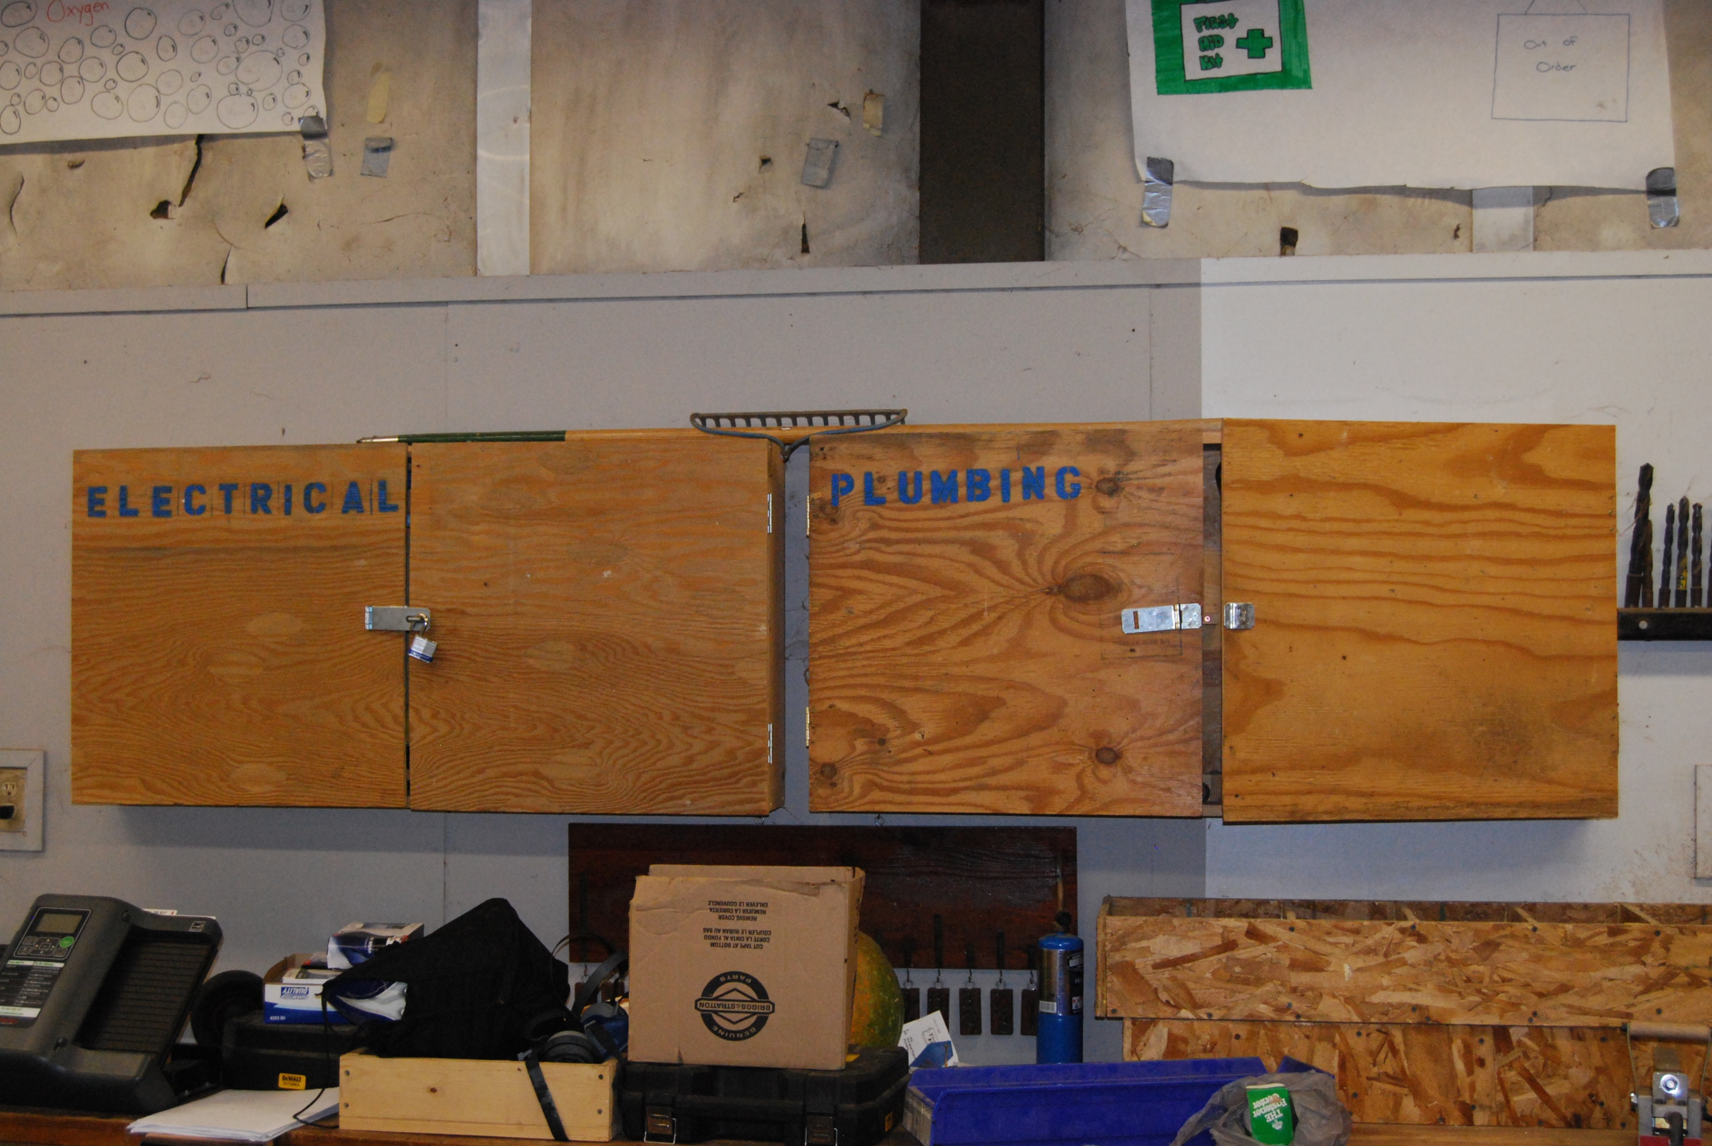
Specialized Tool Storage

Slide 7
Grading & Rubrics
Do by box (faster)
Give points for following the rules
Give points for the correct circuit (covers multiple boxes)
Consider “neatness” for things like stripping of NM cable sheath
Note: Most issues can be fixed! Make students do it right.
What might you grade on the last project you wired?

Slide 8
Testing
It is fun!
Students like to see their project work.
Visually check for loose wires
Do not test when hot wires are grounded to the box.
Loosely install devices in the boxes to prevent shorts (especially to metal boxes)
Use a testing board with a switch.
Have a few plug pig tails.

Slide 9
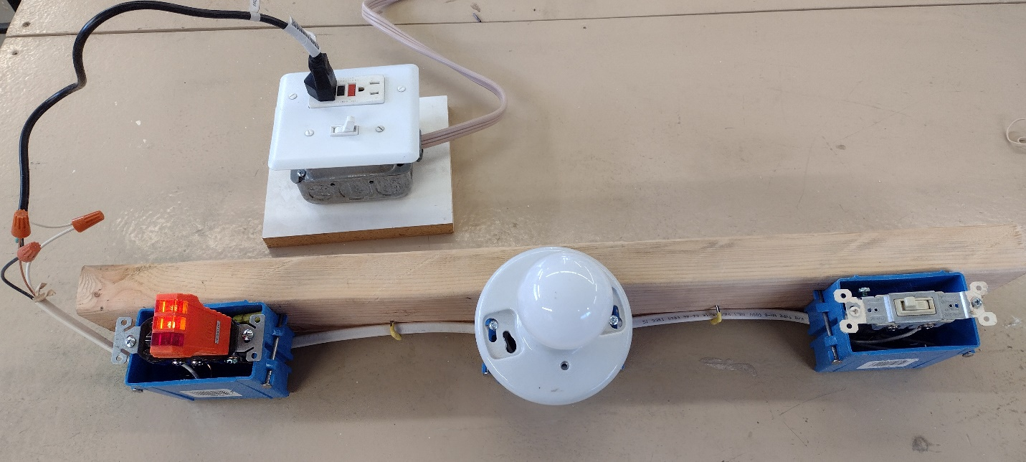
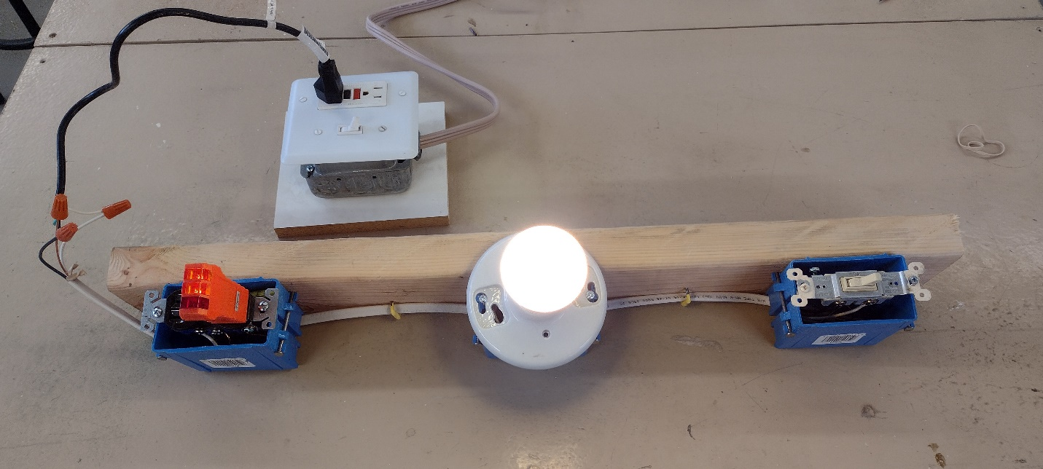
Testing

