Slide 1
Developing Project Resources

Slide 2
Project Based Learning
SLO’s
  Problem Solving
  Construction Techniques
  Layout
Bills of Materials
  Good skill for students
  Use to order materials
Shop Agreements
  Need to have formal agreement to cover costs.

Slide 3
Considerations for Project Selection
Size/Complexity
Shop Tooling
Your Skills
Shop Space

Slide 4
Project Size
Small projects for the entire class
Mid size projects (fire pits, BBQs, etc)
  Fairly easy to manage
  May “stock” common supplies
  May build many of the same, look for details to differentiate.
Large Projects (trailers, scrapers, etc.)
  Components are more complex – find vendors
  Construction techniques often build on those used for smaller projects (ex. squaring a frame)
  Be prepared to handle larger projects (make sure you can get it out of the shop…)

Slide 5
Tooling
Many plans call for specific tools (ex. CNC Plasma Cutter)
Don’t abandon the project just because your don’t have a tool.
Consider:
  Use a different tool or material
  Ask a neighboring program
  Ask a commercial business to help you out
Funding for tooling
  Wish List – 5 year plan

Slide 6
Your skills
Just like your students you “learn by doing”
Consider building some prototypes for experience
Gain skills by working with experienced people
  Cabinet makers
  Electrician
  Fab Shop
  Habitat for Humanity

Slide 7
Shop Space
As projects grow in size and number your space to safely work on them becomes a concern
Plan ahead
Outdoor covered space is a good solution
Plan for portable welders (outlets)
Painting Large Projects :-(
Moving Large Projects (hoist and forklift)

Slide 8
Community
Plan ahead to show projects at the local fair or have a “open house”

Slide 9
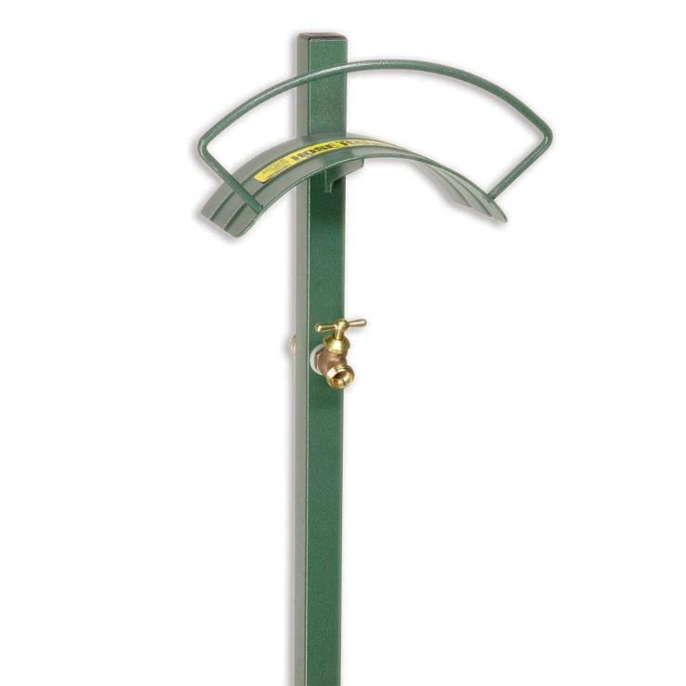
Ideas are Everywhere

Slide 10
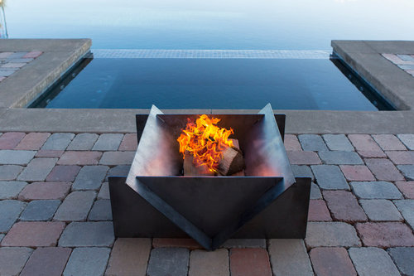
Ideas are Everywhere

Slide 11

Ideas are Everywhere

Slide 12
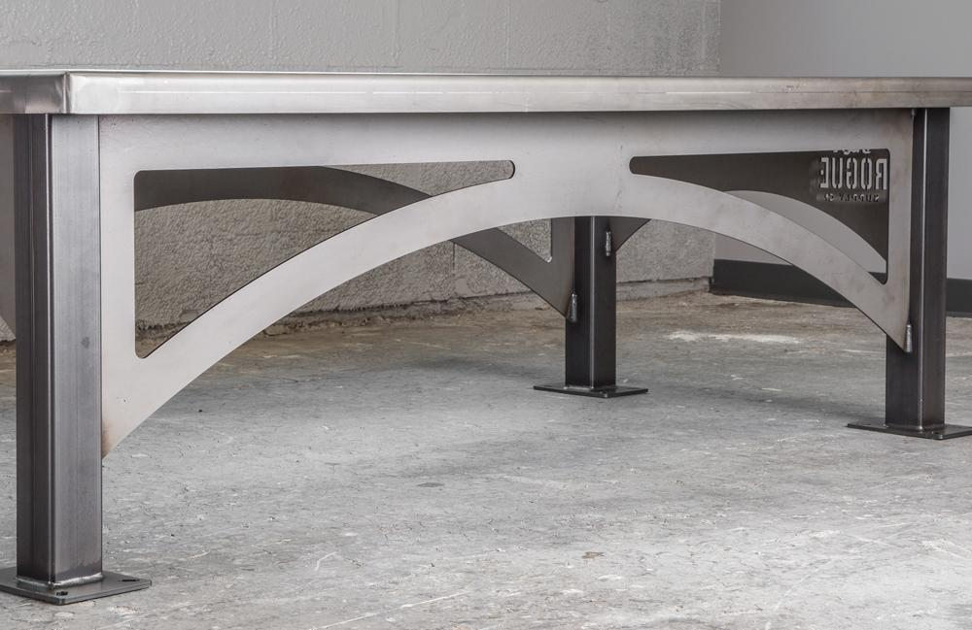
Ideas are Everywhere

Slide 13
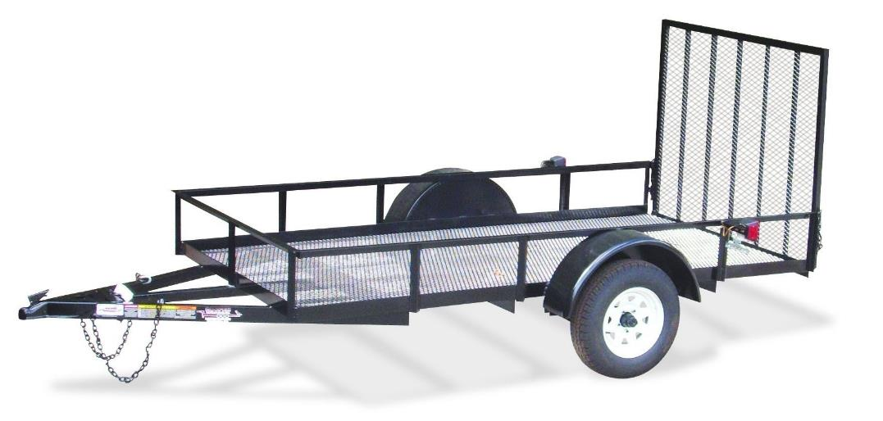
Ideas are Everywhere

Slide 14
Facebook Group
Closed Group (request to join)
Posts typically include
  Cool projects students build
  Ideas for shop management
  Interesting stuff like racing tractors (video)
  Requests for ideas
Partly social, partly professional

Slide 15
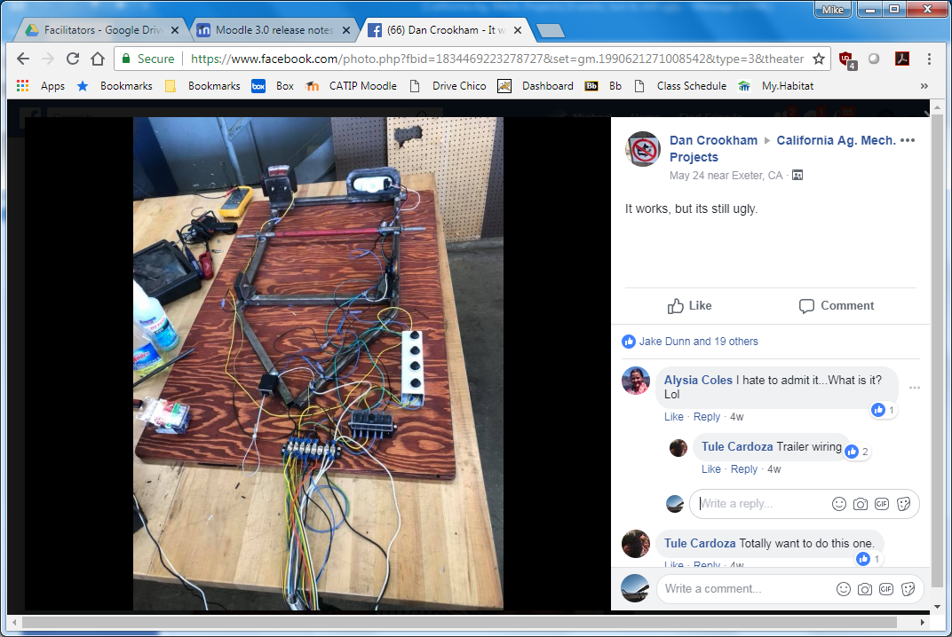
Facebook

Slide 16
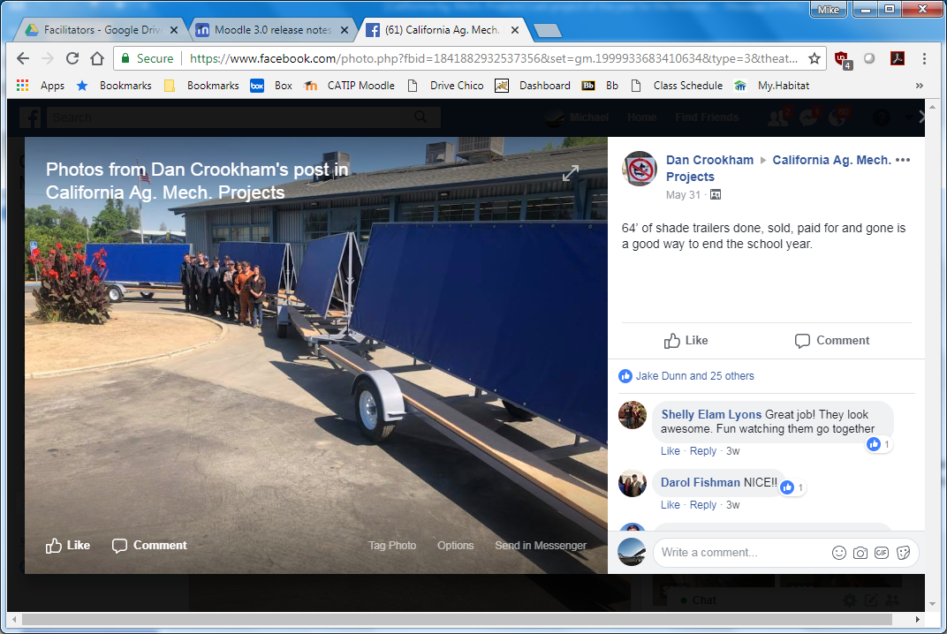
Facebook

Slide 17
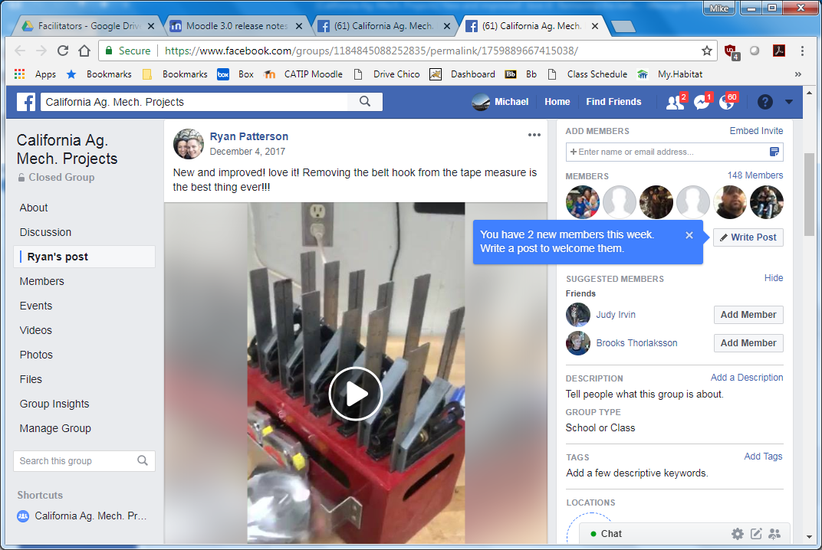
Facebook

Slide 18
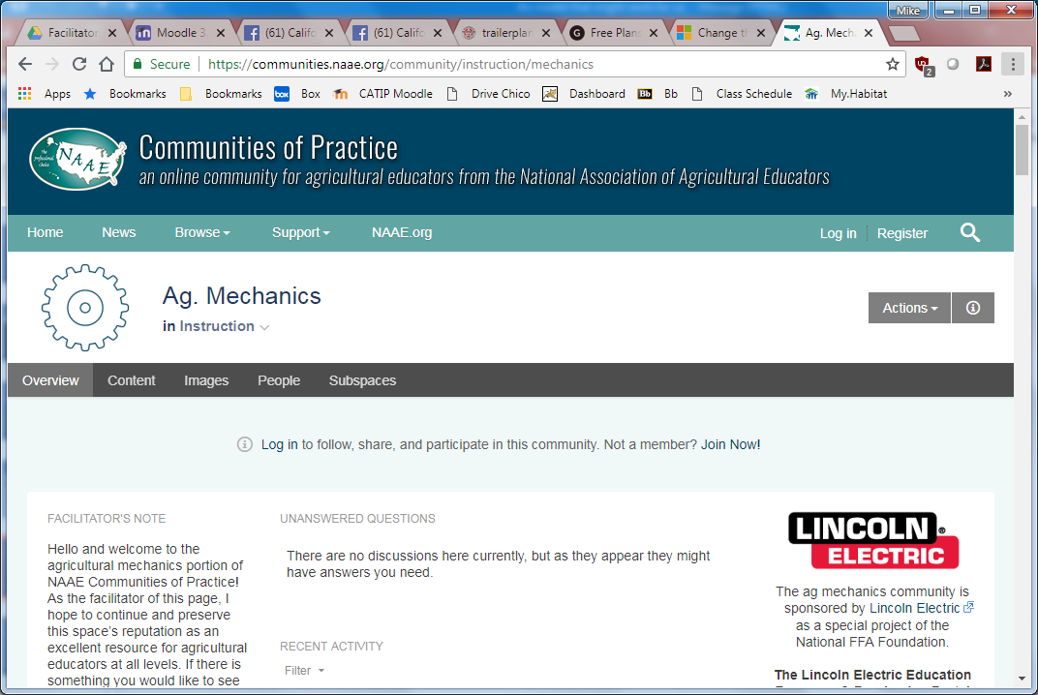
NAAE Communities of Practice (COP)
Discussion List
https://communities.naae.org/community/instruction/mechanics

Slide 19
Web Resources
http://www.agedweb.org/agmechanics
Google Images
https://goo.gl/images/CmG3Sa
http://www.wcwelding.com/storage-shelf-plans.html
http://www.wcwelding.com/fire-pit.html
https://www.bakersgas.com/weldmyworld/2011/05/03/how-to-weld-an-ornamental-gate/
http://www.wcwelding.com/smoker-build.html
https://trailerpartsunlimited.com/
http://redwingsteelworks.com/free-plans/

