Slide 1
Small Shop Projects
Mike Spiess, Brett Baker, Michael Thomas

Slide 2
Introduction
Introductions – Name, School, Years Teaching
Agenda
  Overview
  Project 1
  Project 2
  Project 3
  Wrap Up

Slide 3
Overview
Student Learning Outcomes
Tooling
Projects
Your Skills
Course Management

Slide 4
SLOs
Many projects require measuring, plan reading, layout. Projects should build on these basic skills.
The mix of projects should achieve the SLOs for the course or pathway.
Don’t be afraid to alter projects to fit your desired SLOs

Slide 5
Tooling
Tooling can be limited, but commonly projects can be built with different tools. For example use pop rivets or a spot welder.
SLOs may be targeted to use of different tools. For example you may want students to use a circular saw. So cut with the circular saw not a miter saw. Use a band saw or a jig saw.
Budget for tools to fill in gaps.

Slide 6
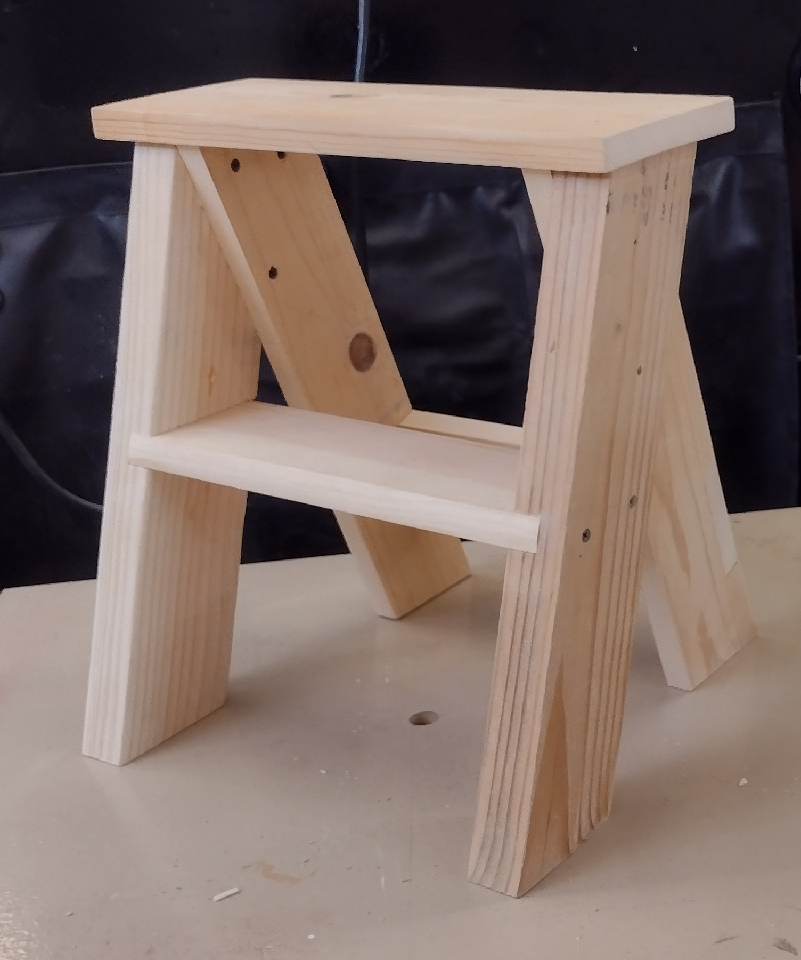
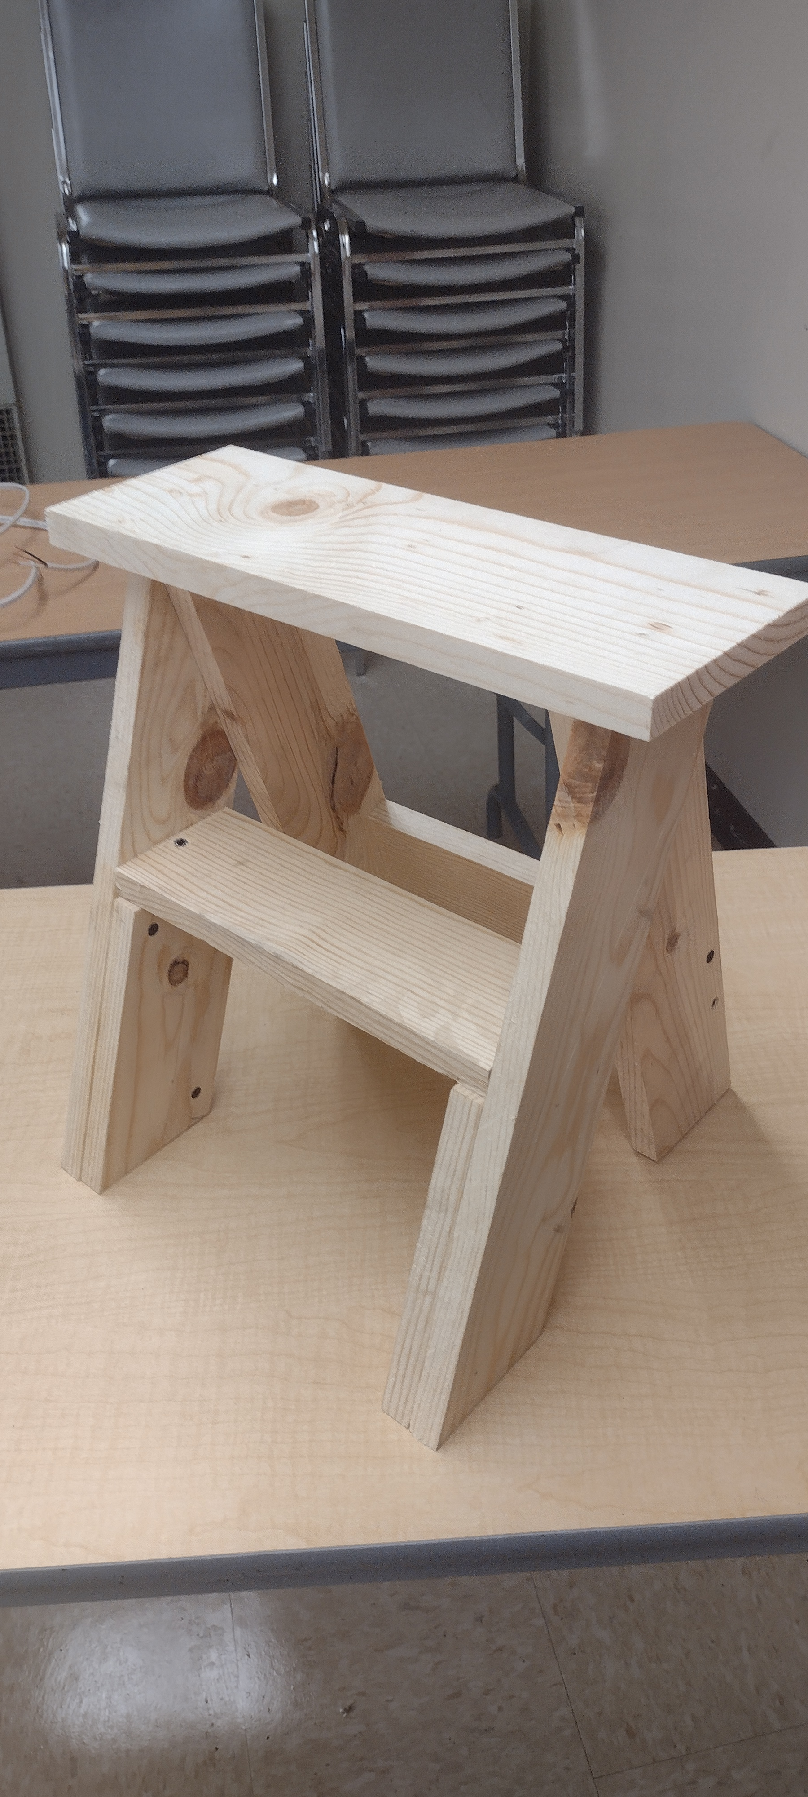
Step Stool Example

Slide 7
Your Skills
Practice!
Look for professional tips from industry or veteran teachers

Slide 8
Course Management
Class Size
Bottlenecks
Rotations
More students = Less projects

Slide 9
Safety Review
Safety Glasses
Power Miter Saw
  Securely material to fence
  Hands width away from blade
  Smooth gentle action
  Don’t cross hands
Hot Metal
  Use gloves
  Be careful around other students with hot steel
Drill Press
  Clamp Metal
Brad Nailer
  Hold material out of range of the nails
  Don’t point at people
Band Saw
  Hands away from blade
  Care with tight radius
Electricity
  Insert probes carefully with fingers off the metal tips!
  Secure devices before energizing.

Slide 10
Workshop Project Selection
See SLO matrix
Select 1 project for each rotation
Select projects that will increase your skills, not ones that you are comfortable with!

Slide 11

Wrap Up
Thoughts on the workshop?
Plans are all online (QR code) see handout.
Lots of other projects: http://www.agedweb.org/AgMechanicsCurriculumProject/Projects/index.htm
Evaluation

